Slide 1


Human Identification with Face Recognition & Social Media Integration
SSIP Pitch Presentation - I
A.V. Parekh Technical Institute
Computer Engineering Department
(NBA Accredited)

Slide 2
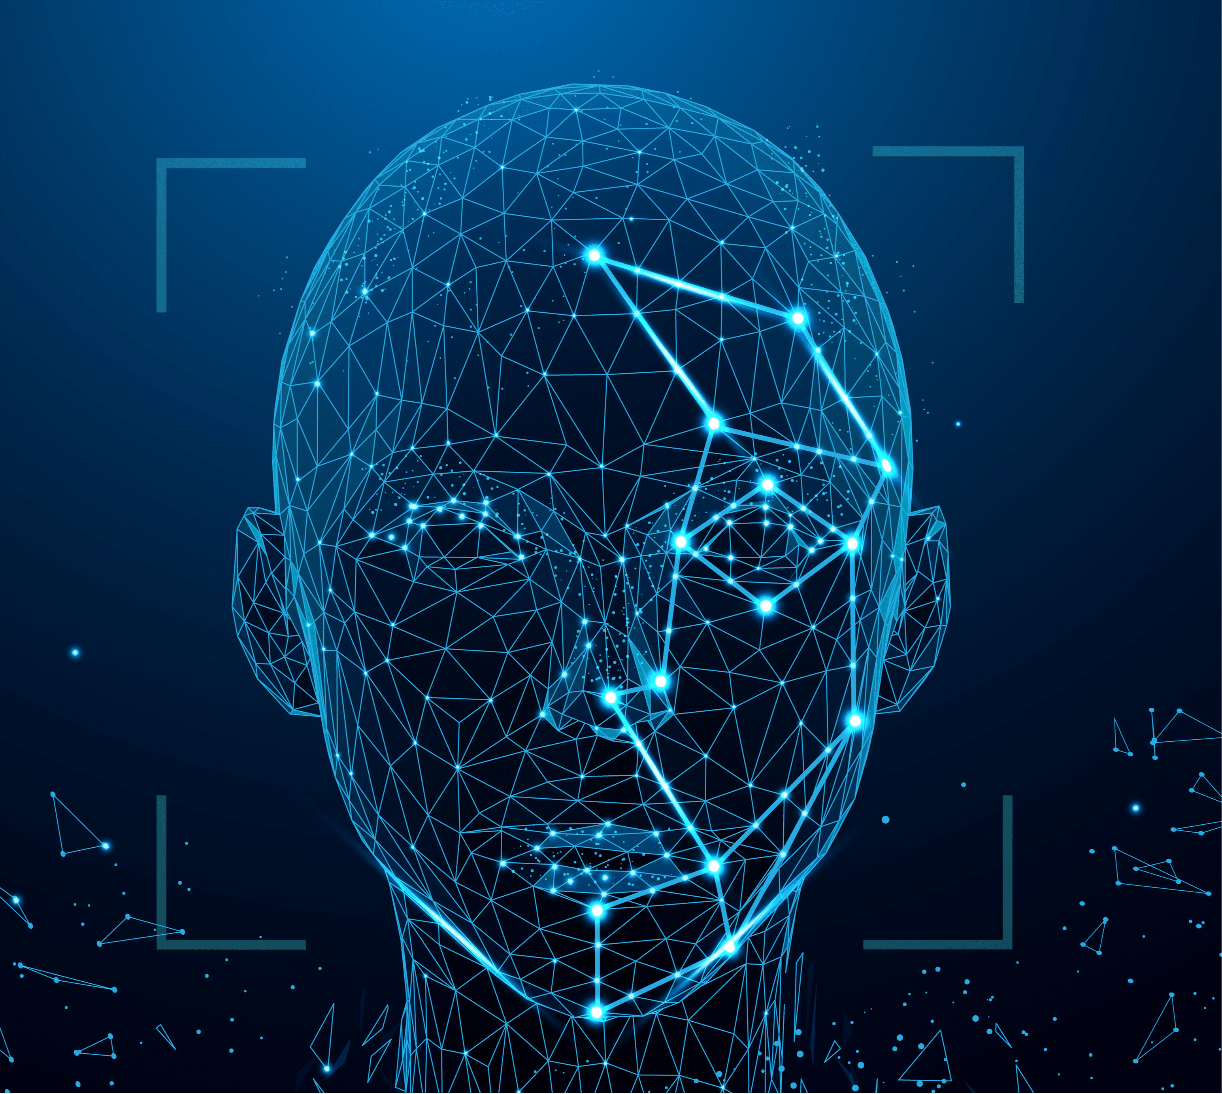
INTRODUCTION
Face recognition is a step further to face detection. In face detection, we only detect the location of the human face in an image but in face recognition, we make a system that can identify humans.
Face recognition is a broad challenge of verifying or identifying people in pictures or videos.

Slide 3
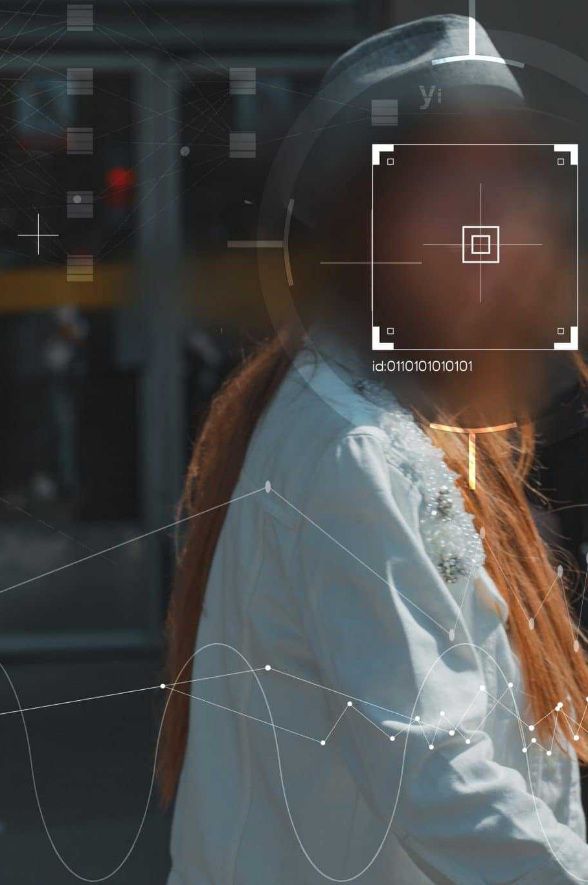
Problem
Slow
Issues for Social Media Platforms
Lack of Integration
Traditional human identification methods are often slow, inefficient, and unreliable.
Problems verifying user identities.
Increased incidents of fraud and impersonation.
No seamless integration between advanced face recognition technology and social media data.

Slide 4
Solution
Integration
Verification
Fraud Detection and Prevention
We will provide integrated system that combines face recognition technology with social media data to quickly process large volumes of information
We will Integrate face recognition systems within social media platforms to verify user identities during account creation and login processes.
We can utilize face recognition to detect and flag suspicious activities, such as multiple accounts with similar facial features or profiles using fake images.

Slide 5
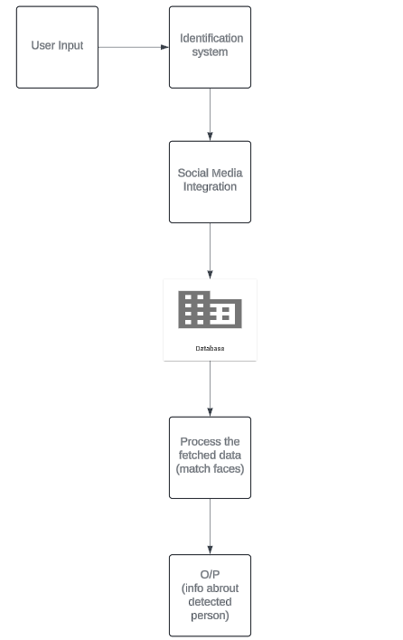
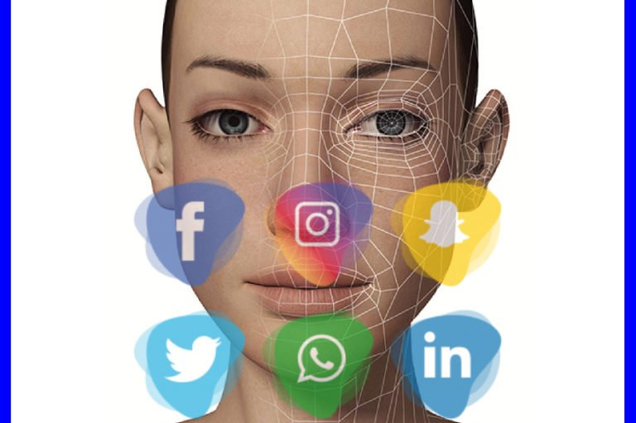
WORKING

Slide 6
Target users

Slide 7
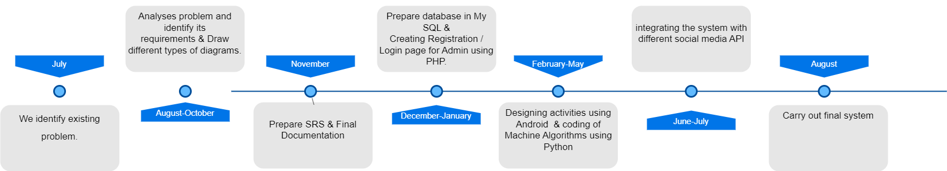
TIMELINE

Slide 8
FUND REQUIREMENT
Camera Price
50%
20%
Application Hosting

Slide 9
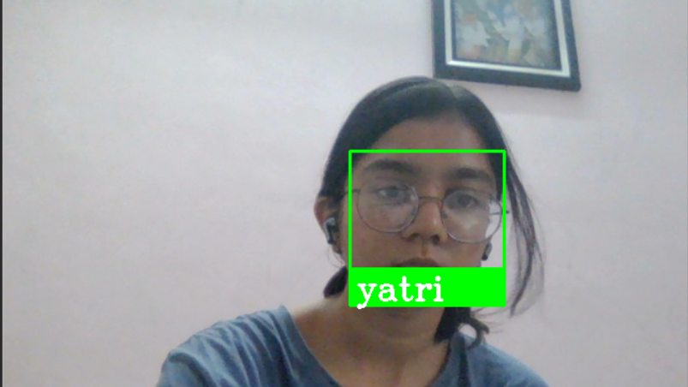
DEMO WORKING

Slide 10
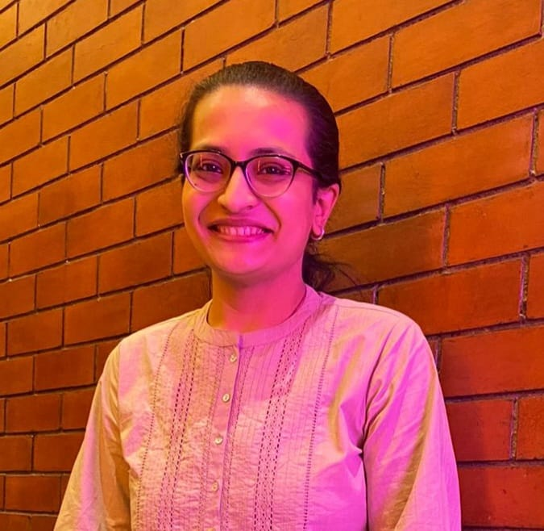



Our team
GUIDE
TEAM MEMBERS
Darshita pathak
Yatri c. chhatrala
Jenisa k. vasani​​
drashti m. makwana​​
Lecturer CE
Python coding, android coding
Python coding,html,css​
Python coding​

Slide 11
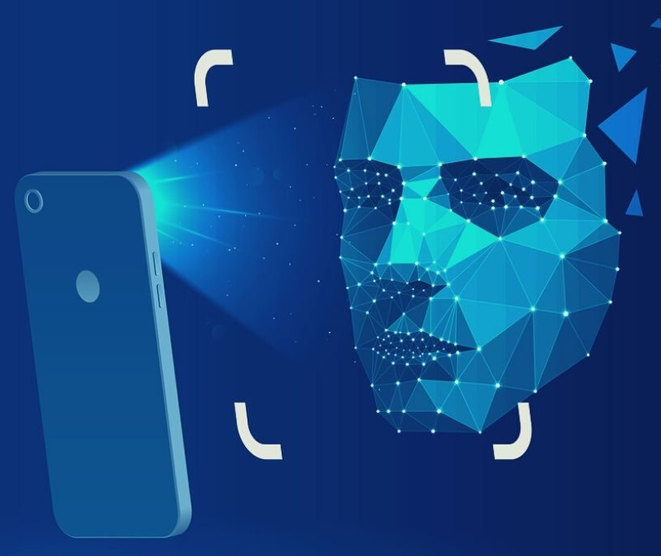
Thank you

